Slide 1
Importance of goals setting
Kawae 20181019

Slide 2
No one plans to fail but people can fail to plan!
In 1979, Harvard conducted a survey of their MBAs.
100 | 3% | 13% | 84%
Setting goals |  |  | Without goals
Profit gained in 10years | 10times | 2times | 1time

Slide 3
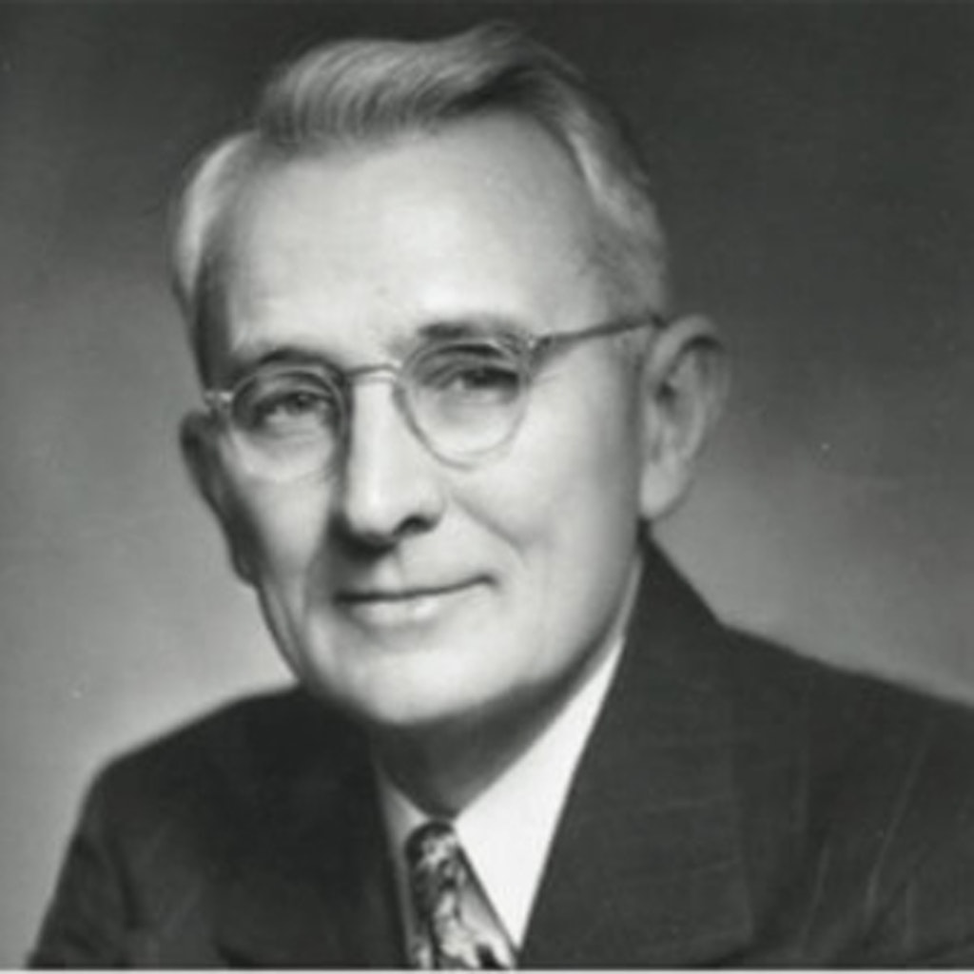
Master of Success Dale Carnegie has said,
「Without a goal, nothing would happen and no one will take any actions.」

Slide 4
Importance of goals setting - interview in university(9)
Setting goal is a way to motivate us to move forward and not to give up easily Setting goal is a way to pursue our dream and make us not to look like a salted fish Setting goal is a way to help us to clarify our current process and help us to do better time management Setting goal is a way to push us to finish our work and prevent us to become a deadline fighter Setting goal is way to let us not to do something frivolously and complete work more effectively Setting goal is a way to set a new benchmark and not to lose your way in the sea of life Setting goal is a way to let us know what are we working for and what is important so we can be perseverance
Setting goal is giving me a more accurate direction for me to work and have a better time arrangement, moreover, reducing indolence.Achieving your goals, you can increase your self-esteem and sense of compliment You can only improve while you have goals. If you don't have one, you will be very dejected and live your life without a fixed direction.
Notes:
動機與動力 極度渴望 不找任何藉口 除走思想限制

Slide 5
Goal setting
Act
Realize Get reward
Notes:
很多人知道但做不到1/知道的不多 2/根本沒有悟到，只是聽到而已 你知道，代表你真的知道很徹底，才會做得到。如果能做到徹底把目標都貫徹到身體每一個角落去就一定能做到

Slide 6
Bible：
Now unto him that is able to do exceeding abundantly above all that we ask or think, according to the power that worketh in us!
Think and Grow Rich：
All things that people can imagine and believe, will be realized one day!

Slide 7
What Goals that you choose
Will decide what life that
you will live
Today’s goal becomes the
REALITY in your future

Slide 8
How to set your goals and achieve them?
You have to keep asking this question, “what kind of person do you want to be” “What kind of life do you want to have”. The goals will change your own perspective and change all the things in your life.
Setting action plan: short . middle . long
Every days/weeks/months/quarters/years/3-5-8-10years
Through lifelong learning, practicing, adjusting and accumulating.
Notes:
改變你的時間管理,改變你所有的生活作息,改變你交朋友的方式,改變你拜誰做你的老師,改變你要放棄什麼跟改變什麼,改變一大堆的事情

Slide 9
Find the core target
Find an image for it
The target will decide what kind of life you are developing
Affluent and with love
The target will decide what power you will have Be positive and fill with joy
The target will decide what you need to change
or abandon
Holding 3 things at the same time and reduce your
entertainments and desires
The target will decide what team you will build Faith, hope and love
Why?
For who?
By what？

Slide 10
The next miracle in your life
Who do I want to be?
Who am I?
BIG WHY
What is the meaning of coming to this world?
Why am I coming to this world?
Notes:
你不知道你是誰，就不知道去哪裏，不知道要做什麼。你就不會快樂，就不會有足夠自信和勇氣去開發你與生俱來的才華。

Slide 11
My dream
Past/Present
Future
entrepreneurship
UFO
Graduated from secondary five
Trade merchandiser
Housewife
Psychologist
Live out love in your heart
Be other's blessing
CHANGE
Notes:
打工，創業，進修？

Slide 12
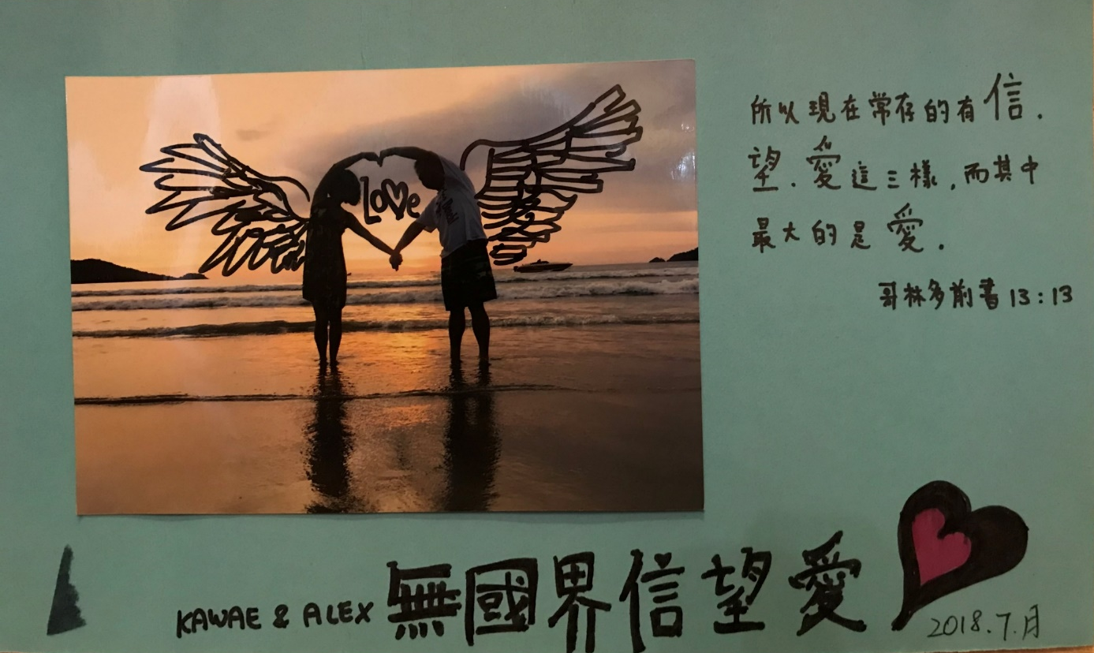
Abundant Life in grace
entrepreneurship
UFO
Living an enriched life everyday
Notes:
動機與動力 極度渴望 不找任何藉口 除走思想限制

Slide 13
200,000 ED
Housing
Vehicle(transportation)
Debt / Investment / Education
Travel
Four-person expenses
Insurance
Family expense
The couples finish the short-term missions around the world
Children can go travel once a year
Parents can go travel once a year
Siblings = gathering in festivals
Friends/Partners = Go travel every year
*Bachelor(Psychology)
New skill
*New hobby(Dancing)
*Musical equipment(Drum)
Mission
*The Faith, Hope and Love Endowment Fund :
with man, with heart and with good service
Live out a bigger mission
Life
Affection
65,000
Worry-free
Time
Your target should be S.M.A.R.T.
Learn
Contribution
Individual interest
Value-adding
Give back to the society
Financial freedom: You are always safe and guaranteed not to consider money
Time freedom : a trip without plan or sleep until naturally awake
Gift freedom : free life in both physical and mental integrity
Notes:
SpecificMeasurableAttainableRealisticTimely

Slide 14
Goal Setting (Business plan – 5 steps)
Reward Punishment
1. What goal do you want to achieve?
2. How long do you want to achieve it?
3. What costs you and what is the difficulty?
4. A detail successful plan
5. Write it on the paper (Step 1~4) Read it twice a day
K$2300 - HK$57,500 Supervising Coordinator
Within 1~2years
Within 2~3years
Mind Time Finance
MUFO Director Challenge Buy and sale ticket

Slide 15
Goal declaration 50-100 words twice a day
Today, November 12 in 2020, Alex and me start our journey of faith, hope and love without boarder. Living a both physical and mental freedom life without fear and go for trips without plan, fulfilling big missions, living out the love inside our hearts, being other's blessing, we use our life to affect other's life and live out a flourish life in grace that given by God.
Thank you to ourself 10 years before. We trusted in following the system and dedicated ourself with unfailing efforts. We insisted and developed our Unfranchise® business. Thank you to all the difficulties and challenges that we faced for becoming the nutritions of accomplishing our breakthrough. We don't have to work for others anymore. Replacing pressure by motion, we can fully dedicate into this business that changed our world.
Therefore, the new me and Alex rely on the Almighty God who created everything and always full of joy. We are positive and not fear of any challenge. Dedicating to spend at least 2 hours a day to learn to develop the business.At 2019, we are completing ED on 12th of November. The commission will reach $200,000 for four weeks. Colleagues will help to get more active partners and to earn ongoing income, resulting in 30EC, 10MC, 5SMC, 2PC, 2SC and 1NSC more.

Slide 16
Action Plan Small goals achieve big dream
Master Unfranchise Owner PROGRAM
You want to get what you never got You have to pay what you never paid
An successful Unfranchise Business system
only for MHK Unfranchise Business Owner
Notes:
每一個階段都需要脫胎換骨

Slide 17
Action Plan Small goals achieve big dream
Use and sell products
Share the business
Share the
Shopping Annuity
Sell Tickets (Trainings)

Slide 18
Action Plan Small goals achieve big dream
GMTSS leverage meeting
Essential : NUOT B5 ECCT | Main: H+M TLS Motives Web PS | World Conference HK TW MY USA Product symposium | Second after convention MUFO Team activity One to One ABC
Change your fate through learning

Slide 19
Action plan Small goals achieve big dream
Short．Middle．Long
Set an example : Dedicate yourself in 2018 and Earn you money while you are learning and enjoying
Insist to do this every day: 3．2．1 Goals declaration Spend less
Insist to do this every week: MUFO/group activity/gonow partner communication/senior partner communication
Insist to do this every month: participate four times GMTSS/ 500BV
Insist to do this every quarter : complete MUFO/SAMM
Insist to do this every year : Hong Kong, Taiwan and America convention, Hong Kong product symposium
Insist to buy and sell tickets and so achieving leverage
Insist to use ABC Pattern/ Rule to duplicate more A (12A)
Insist to assist you team to run the pattern and nurture more leaders (12A)
To do what I should do,
then do what I like to do
TO DO LIST
Recognition levels:
EC $11500
MC $16100
SMC $23000
PC $34500
SC $57500
NSC $76000
ESC $115000
Director $138000
30
10
5
2
2
1
Team goals
Hong Kong Convention: 300
Taiwan Convention: 100
America Convention: 30
Hong Kong Product symposium: 50
Increase the number of new UFO: 240-320

Slide 20
Action plan Small goals achieve big dream
 | Mon | Tue | Wed | Thu | Fri | Sat | Sun
AM |  |  |  |  |  |  | 14
Lunch | 1 | 2 | 3 | 4 | 5 | 11 | 15
PM |  |  |  |  |  | 12 | 16
evening | 6 | 7 | 8 | 9 | 10 | 13 | 17
48hours every months, 12hours every weeks
Calling your leaders/partners every weeks
Join UBP / HBP once in two weeks
Participate GMTSS once a month - NUOT / Basic 5
Join CORING every weeks
ABC pattern
manage UFMS every weeks
Watch the new business/products from new friends in ABC (twice a week )
2 hours - 30 minutes each X 4
3 hours - 1.5 hours each X 2
3 hours
8 hours - 2 hours each X 4
4 hours - 1 hours each X 4
4 hours - 1 hours each X 4
24 hours - 3 hours each
48 hours
Family
Focus on action
Spend around 12hours to develop the business every weeks. You will finish one shop in 2-3 years!
Notes:
目標最重要的四個字專注行動

Slide 21
Measure, examine, adjust and control
Based on the results of your actions:
Adjustment to completion date
Adjustment to the action plan
Participate more training
Conduct a B5 test on a regular basis to assess the progress

Slide 22
All entrepreneur who is starting your business:
When there is challenge or chance,
Sometimes I may think that I can’t do that.
Sometimes I’d think that i am living in a fairly good life.
Sometimes I'd encounter frustration
But more often is that I really want to give up…
However, all successful people are perserverance
Over come every difficulty！

Slide 23
Never give up Nick Vujicic

Slide 24
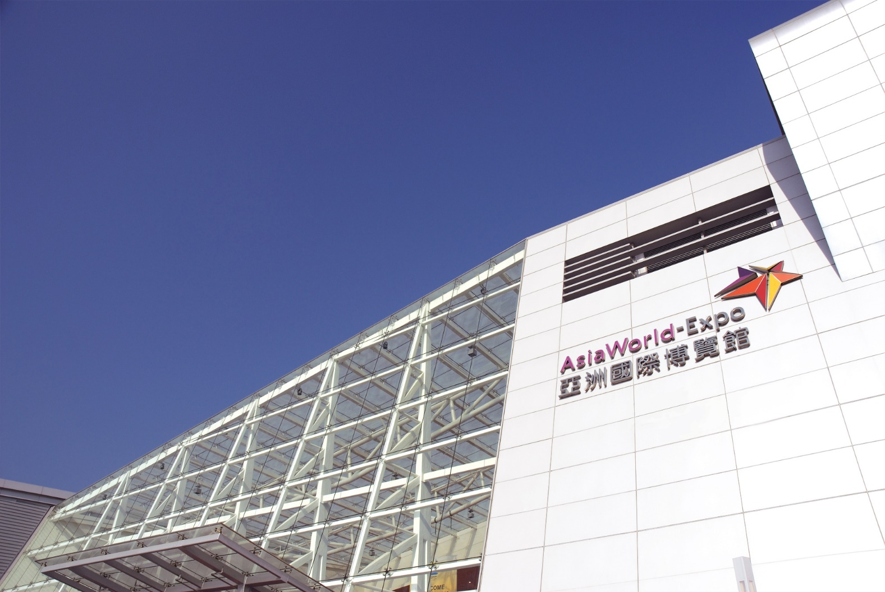
2019 Market Hong Kong Annual Convention
Purchase 3 tickets in a single order will receive 1 ticket to one of the special breakout trainings below. Quantities are LIMITED!
David Lin, Field Vice President Monday, Oct. 22, 3:00 – 5:00 p.m.
Frank Chang, Director Monday, Oct. 22, 7:30 – 9:30 p.m.
Kevin Buckman (with translation service), Senior Consultant, Market America, Inc. Tuesday, Oct. 23, 9:30a.m. – 1:30p.m.
Emmy Yeung, Product Marketing Manager Stephen Ngan, JAS & Associates Head of Healthcare Marketing Tuesday, Oct. 23, 3:00 – 5:00 p.m.
29 – 31 March 2019
SKU 2188_HKAC19

